Slide 1
Wireless Security

Slide 2


Wireless Security
Never use default settings
Change the default SSID
SSID is the WiFi’s name
Example: “Coffee Shop WiFi”
Change the default password
Easy to find a default password
Should never use the default password

Slide 3
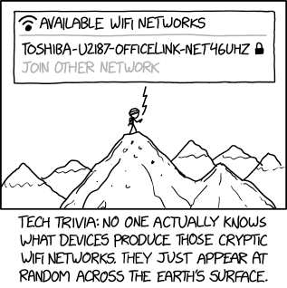
Source: https://xkcd.com/2199/

Slide 4
Wireless Security
Encryption Standards
Open - No encryption
Very unsecure
WEP (Wired Equivalent Privacy)
Outdated
40-bit encryption
WPA (Wireless Protected Access)
More secure than WEP
WPA2 (Wireless Protected Access 2)
Enhanced WPA

